Slide 1
Robotics programming with ROS
Introduction and installation
Notes:
Hi everyone, welcome to Robotics programming with ROS
ROS stands for the Robot Operating System, which is a free and open source library for robotics programming.
My hope with this video is to show you that with an Ubuntu Linux computer and some knowledge of programming, you can quickly get started programming robots.
And in fact, you don't even need a robot to get started, we're going to run a pretty realistic simulated robot.

Slide 2
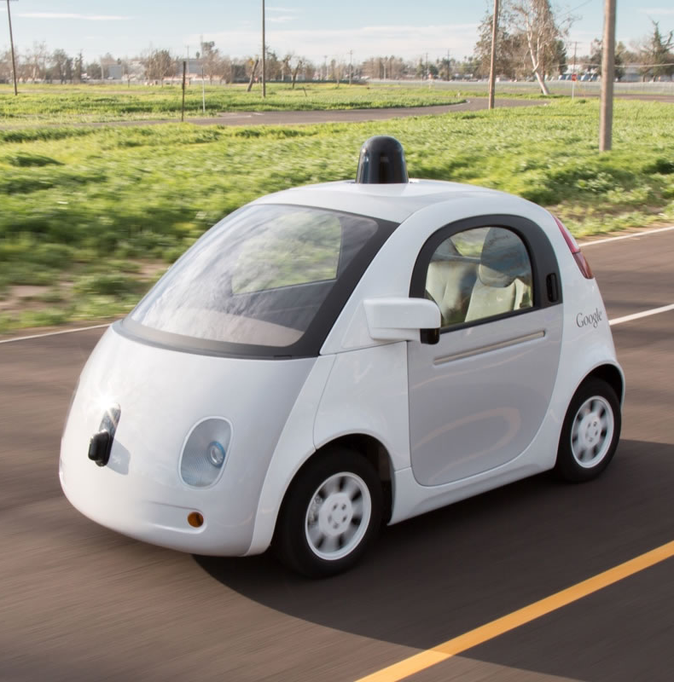
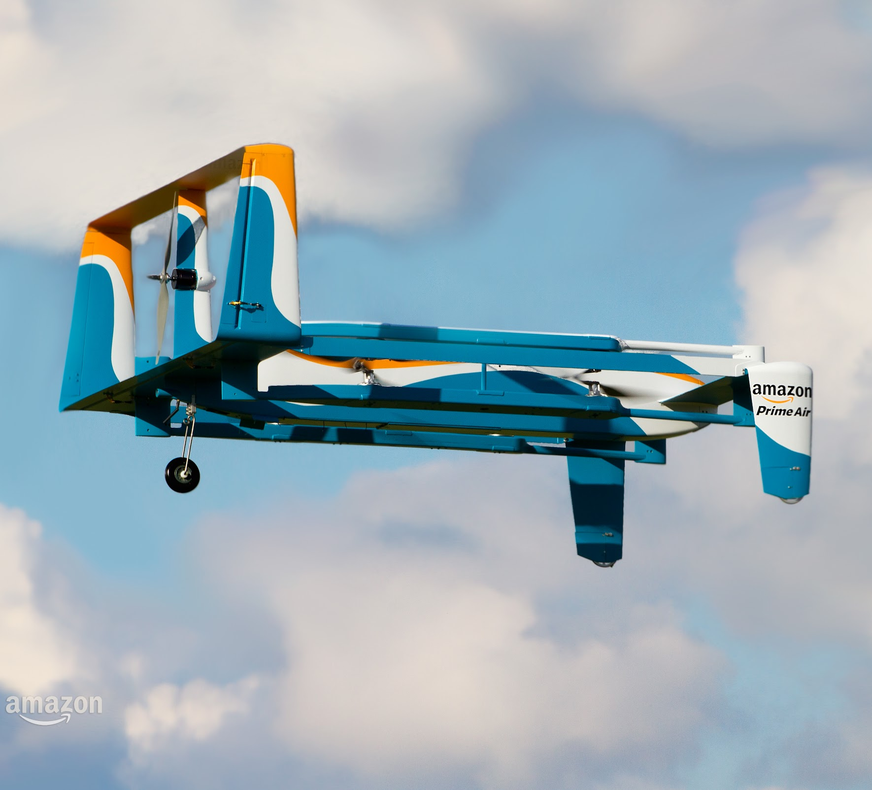
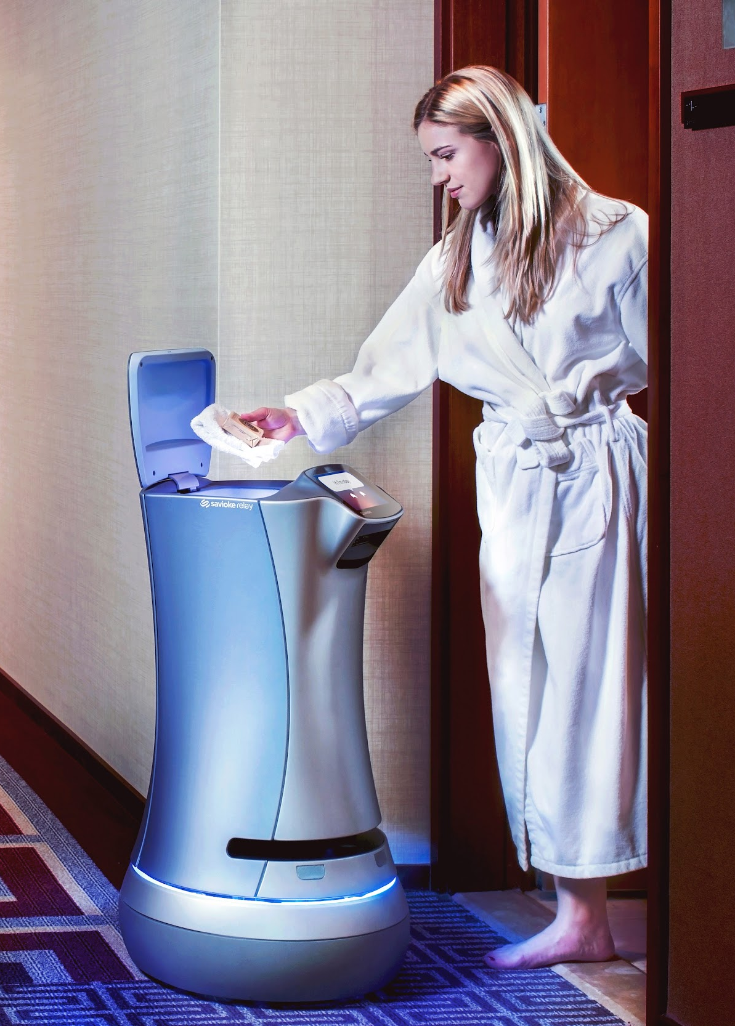
Google Self-Driving Car
Amazon Prime Air
Savioke Relay
Robotics in the real world

Slide 3
What is ROS?
A software framework for programming robots
Prototypes originated from Stanford AI research, officially created and developed by Willow Garage starting in 2007
Currently maintained by Open Source Robotics Foundation
Consists of infrastructure, tools, capabilities, and ecosystem

Slide 4
Advantages and Disadvantages of ROS
Advantages
Disadvantages
Provides lots of infrastructure, tools, and capabilities
Easy to try other people's work and share your own
Large community
Free, open source, BSD license
Great for open-source and researchers
Approaching maturity, but still changing
Security and scalability are not first-class concerns
OSes other than Ubuntu Linux are not well supported
Not great for mission-critical tasks

Slide 5
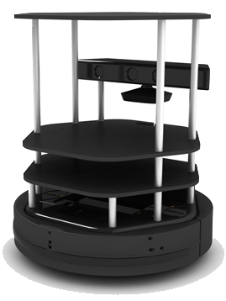
About these tutorials
Focus is on ROS concepts and software engineering
Mostly developing with a Turtlebot in simulation
A mix of explanation and coding
Recommend checking out the official ROS tutorials and documentation
Turtlebot

Slide 6
Prerequisites
Ubuntu Linux 14.04
A fairly recent/fast computer
Mostly to run the simulation
Familiarity with developing in a Linux environment
Knowledge of programming in C++ and/or Python

Slide 7
Installing ROS and running the Turtlebot simulation!

